Slide 4
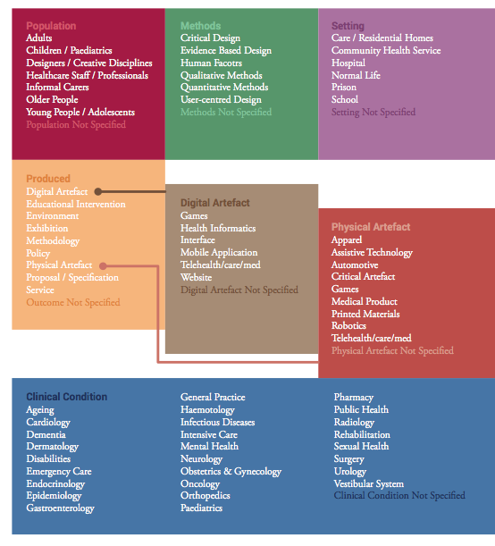

Slide 5
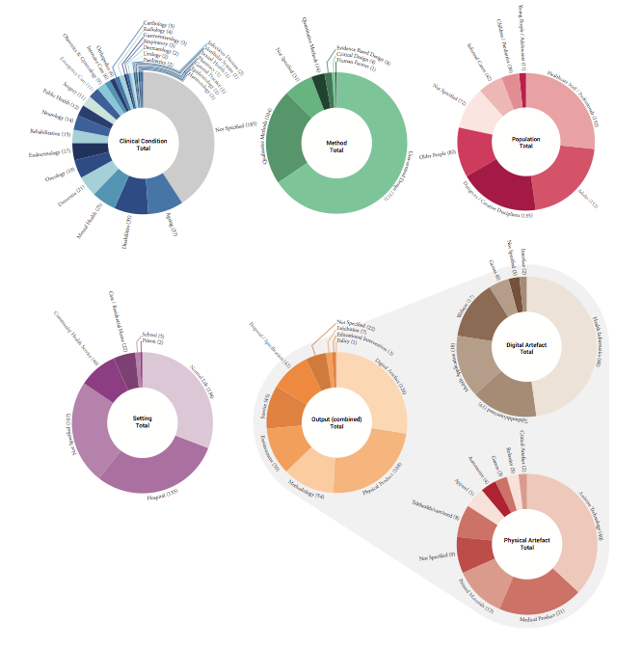

Slide 7
Design for Health is an international refereed journal covering all aspects of design in the context of health and wellbeing. The Journal is published twice a year and provides a forum for design and health scholars, design professionals, health-care practitioners, educators and managers worldwide.

