Slide 1
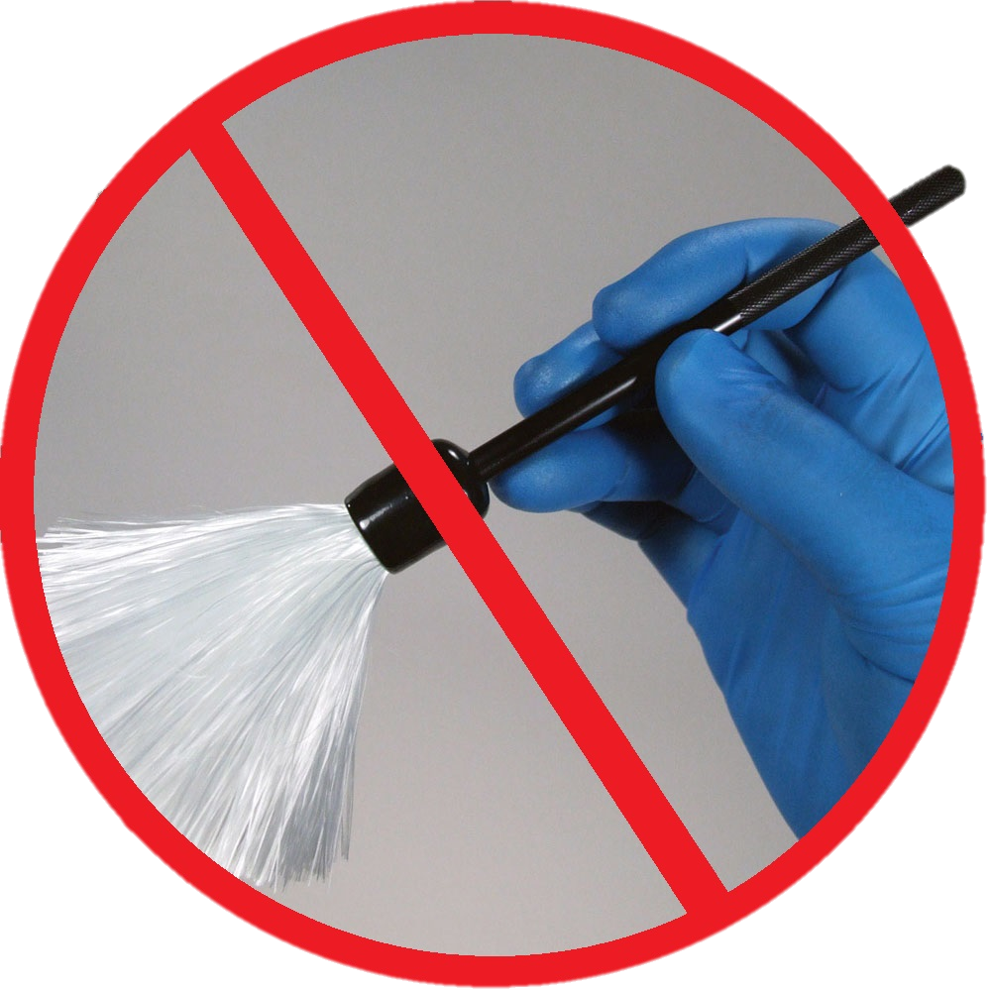
Re-inventing the brush:
Evidence Contamination at Crime Scenes
Presenter: Nataliya Korzhuk
Notes:
This presentation is titled “re-inventing the brush” and this is because the project aims to address some of the current problems with the way evidence is handled by Crime Scene Investigators, or CSIs, at a crime scene – looking specifically at latent fingerprint recovery. Although a variety of methods to develop a fingerprint on most typical surfaces already exists, by far the most popular one is brushing fingerprint powder onto the surface with a squirrel hair or fibreglass brush or a magnetic wand. We are aiming to develop an alternative method, which should reduce some of the risks associated with the current one.

Slide 2
KTP
Knowledge Transfer Partnership - a programme to encourage collaboration between businesses and universities in the United Kingdom. Partly funded by government, partly by the university and the business.
AHRC
Knowledge Base
Company

Slide 3
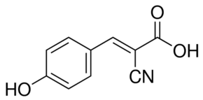
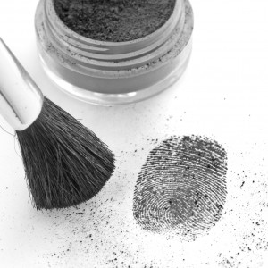
Background
Initial idea – effective deposition of mass spectrometry matrix (fine powdered chemical)
Later developed into an idea for a new device that would use conventional fingerprint powders to visualise fingerprints
MALDI matrix
Conventional fingerprint powder
Notes:
The initial idea for this project stemmed from the research led by Simona Francese, mass spectrometry expert of Sheffield Hallam University, and to begin with, only aimed to devise a method of depositing mass spectrometry matrix, a fine powder, in a very even layer, without introducing any external contaminants. This was important to be able to extract as much information as possible, including some DNA, from a single fingerprint
Later the project evolved into something new, when a gap in the market was found for a device that would make fingerprint recovery easier, reducing the risk of fingerprint damage and potential contamination.

Slide 4
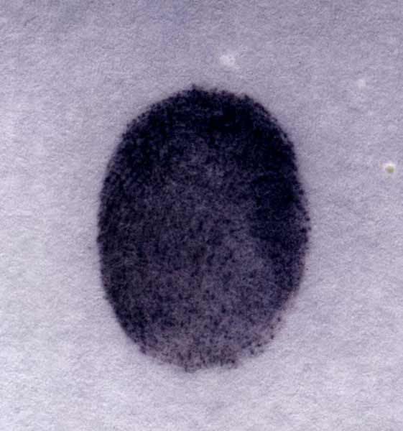
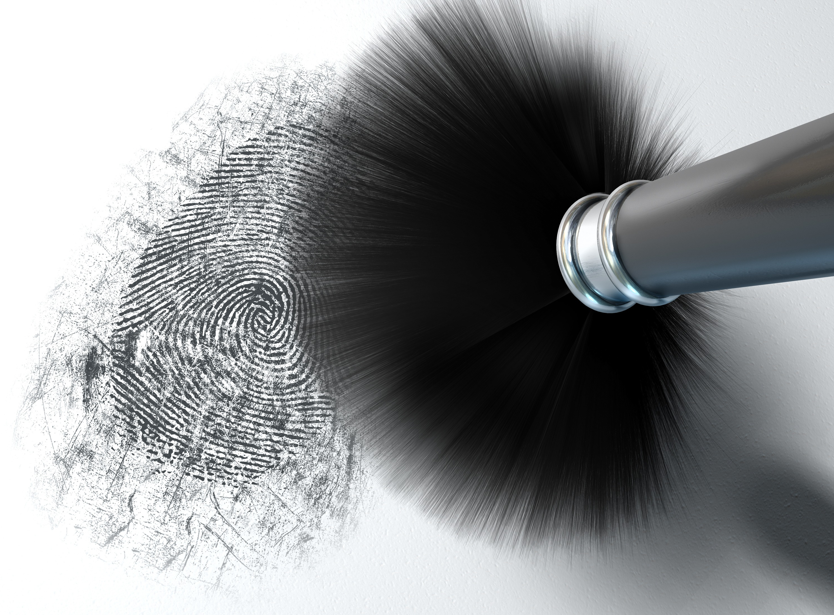
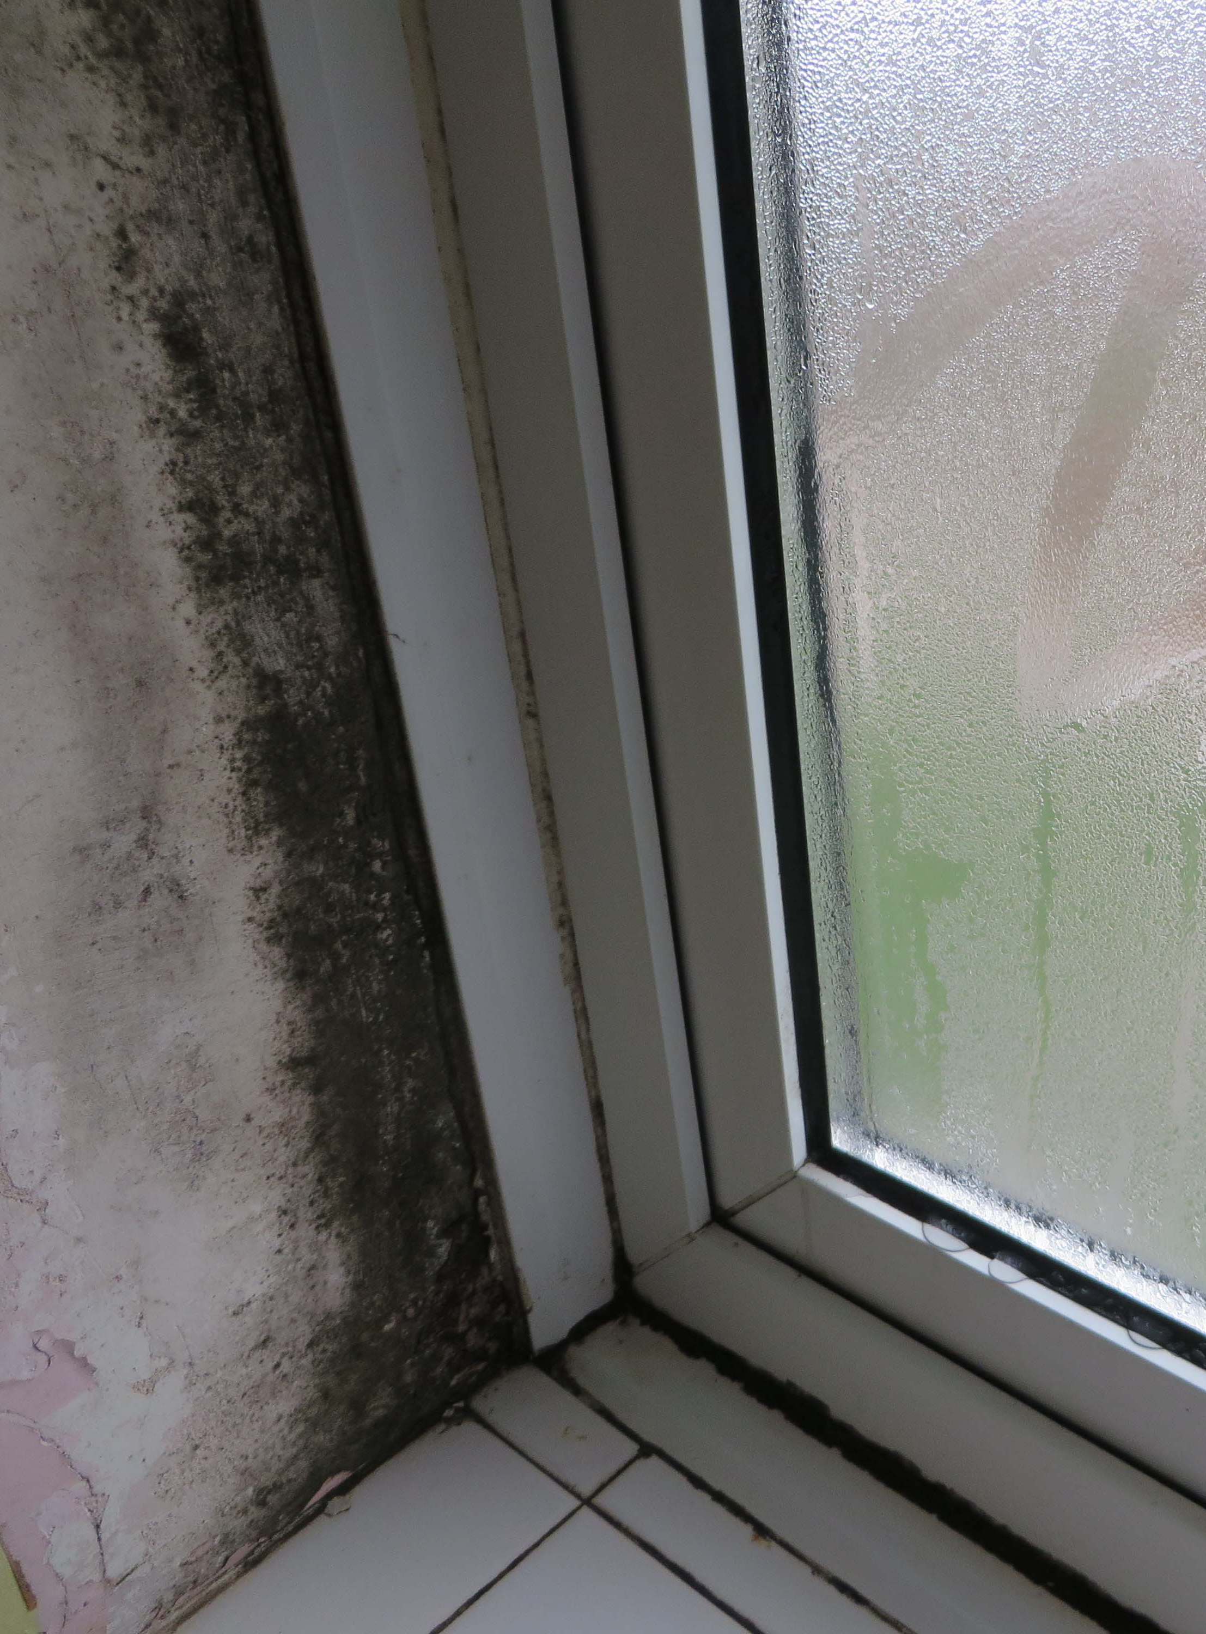
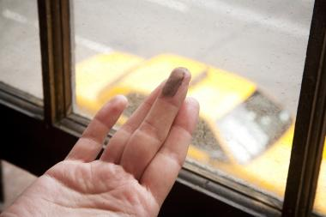
Problem
Contamination with surface dust/dirt
Cross-contamination (possibly with DNA) through brush contact
Accidental overpowdering or damaging the print
Inability to use brush in wet conditions

Slide 5
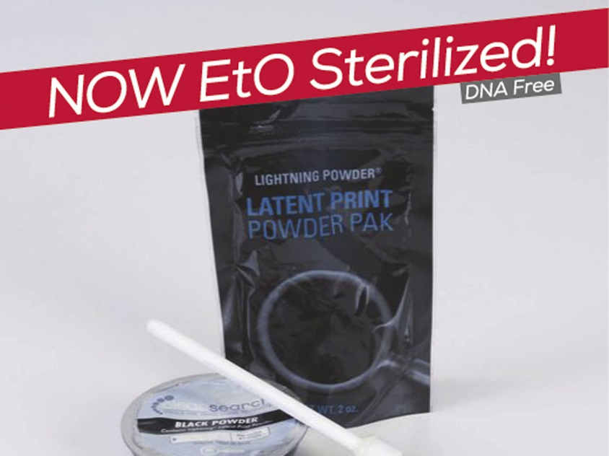
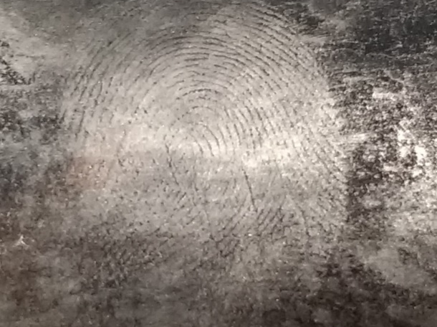
Impact
Fingerprints - a source of DNA material
11,212 serious crimes per police force recorded between 2016-2017, that is 934 per month
Currently implemented practices – powdering last and disposable brushes
Single-use brushes – available hardly ever used
Potential costs– over £2k per police force per month spent on disposable brushes only
Image: http://www.safariland.com

Slide 6
Did you know?
A CSI would visit 3-4 crime scenes per day on average, 20 years ago it could be 20-30
Not every crime scene is searched for fingerprints, and out of those recovered, only about 10% are detailed enough to be used as evidence in court
There are devices that can visualise a fingerprint without coming into contact with the surface, but currently remain to be an expensive (and not easily portable) tech

Slide 7
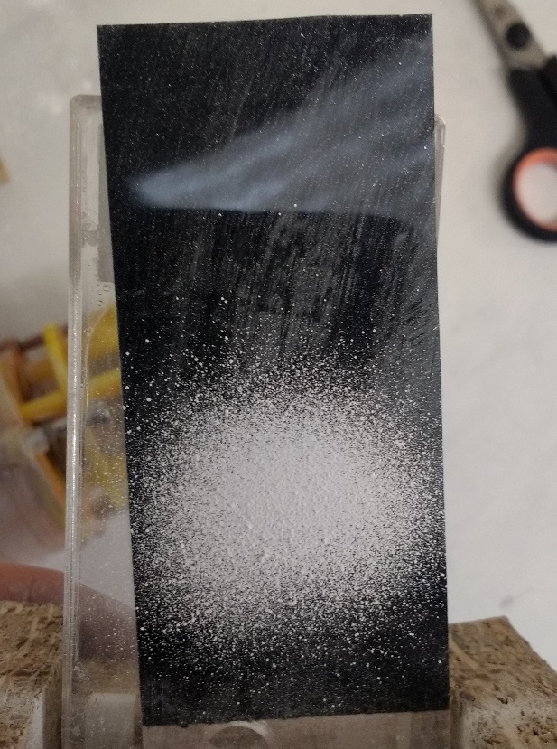
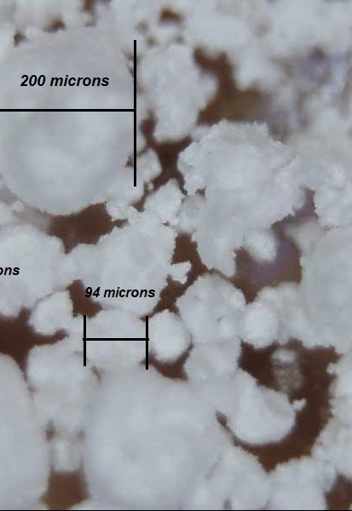
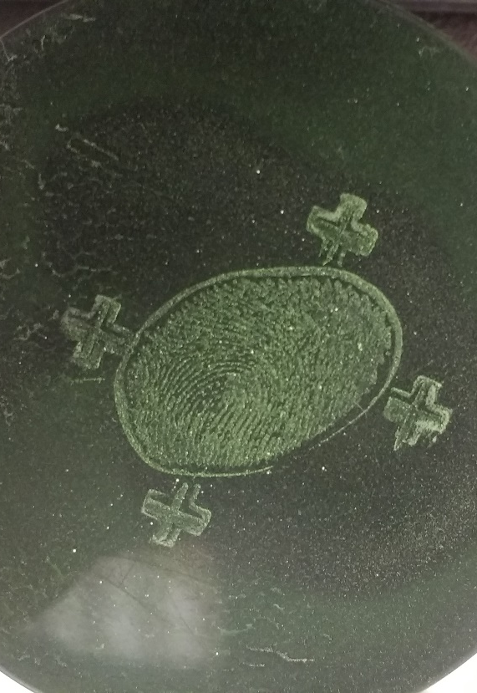
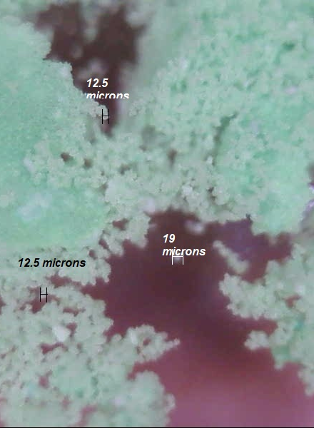
Development and challenges
Powder type

Slide 8
Development and challenges
Patterns
1
2
3
4
Ideal pattern - impression
Test Patterns

Slide 9
Design process
Involving the user early on
Staying in touch
Future user trials

Slide 10
End Result
Controllable
Affordable
Contactless
Easily portable
Fingerprint-safe

Slide 11
Thank you
QUESTIONS?

