Slide 1
Introducing the UKRI Future Leaders Fellowships
Joanna Dunster, Strategy and Development Manager
2 April 2019

Slide 2
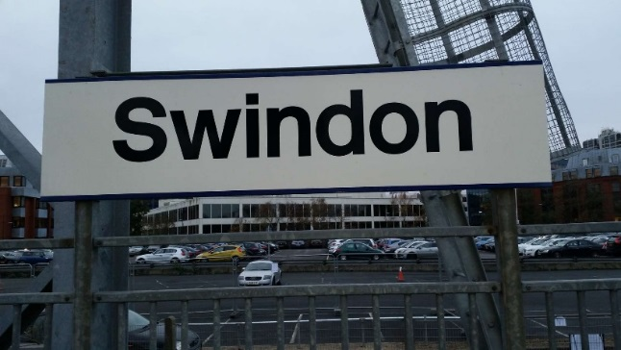
AHRC: part of UKRI
As of 01/04 2018: 7 x Research Councils + Innovate UK + Higher Education Funding Council for England (HEFCE) = UKRI
Improve cross-council working
Harmonise policy and practice
Pool data and evidence
Stronger voice for research in the UK
Notes:
Introduction to AHRC, wider research funding landscape
UKRI launched 1st April 2018
Rationale – improve provision for multi- and inter-disciplinary research
Harmonise policy and practice – more efficient and consistent UX
Pool data-sets for greater evidence base – assess needs and demonstrate value

Slide 3
AHRC: what we fund
Archaeology
Classics
Museum Studies
History
Law
Philosophy
Theology
Dance
Design
Drama
Music
Languages
Literature
Linguistics
lots of other things…
Notes:
Not all about interdisciplinarity at the expense of disciplines – emphasise within AHRC interdisciplinarity
Subject areas
See website
Remit checking function

Slide 4
UKRI: Future Leaders Fellows
Launched 1st April 2018
£900m, 550 awards up to £1.2m
Open to researchers across remit of 7 Councils + Innovate
Administered by central team
Reviewers and panellists from all Councils
No ring-fenced budget for Councils, organisation types or subject areas
Notes:
Launch of UKRI in April this year
Budget of £900m, 550 awards up to £1.2m, 7 yrs duration
Raise baseline of research across remit of 7 councils plus Innovate
All councils + central admin team = interdisciplinary approach
What that means for applicant – no need to pick Council
Reviewers and panellists allocated co-operatively across Councils
No ring-fenced budget – all proposals equally weighted

Slide 5
UKIR: Future Leaders Fellows (cont.)
Early Career Researchers to become research leaders
Objectives: development of the Fellow, world-class research/innovation
Self-defined – Person Specification, Competency-Based
Doctorate or equivalent
Demonstrable support from host organisation:
tapered salary from year 3
open-ended contract at end
80% FEC
Notes:
A scheme to support early career researchers and innovators who have the potential to be leaders in their field
Undertake an ambitious programme of research over up to seven years (four plus three)
Objectives are equally weighted – clear plan for development as well as excellent research
Eligibility – self-defined, broad and inclusive
Requires post-doctoral or equivalent status
Demonstrable support from host organisation
In exchange, strong contribution to the research life of the department
Engagement and leadership activities that raise the profile of the researcher and their group
Support and engagement with UKRI and cohort

Slide 6
Person Specification
Demonstrate knowledge of research area, vision for research excellence
Pathways to impact/influence
Original and ambitious plans, not significantly overlapping with collaborators/supervisor(s)
Suitability of research environment(s) (e.g. HEI, business)
Capable of leadership (e.g. a team, field more widely), maximising potential in others
Notes:
Doctorate or equivalent experience, early career researcher not defined by years since PhD or academic position
Applicants who have secured significant ECR funding as PI will be less competitive, will have to work harder to demonstrate that FLF will enable a shift to independence
Maximum flexibility – part-time, job-shares, 4 + 3 model
Knowledge, vision, support, potential for leadership

Slide 7
Person Specification, cont.
Ability to build partnerships, collaborations, networks
Skills, knowledge, experience appropriate to project
Strong research track record
Opportunities for development as influential research leader
Opportunities for wider career development support
Strong communication skills for a range of audiences
Demonstrate reach and wider relevance of Fellowship
Notes:
Skills and abilities – must be demonstrated in application
Why does this field of research need this project, and you as a researcher?

Slide 8
Assessment Criteria
Research excellence
Importance, novelty, feasibility
Robustness and appropriateness of methodology
Applicant and development
Research track record
Independence and thought leadership
Communication and leadership
Knowledge of research landscape, and contribution
Training and development plan
Notes:
Significant departure from current/previous work – think big
But ensure it’s feasible, methodology is clear and justified – do you need advice from other subject areas beyond your own? Co-I? Mentor? Advisory body?
Why you? What will this award do for you?

Slide 9
Assessment Criteria (cont.)
Impact and strategic relevance
Pathways to impact are well understood and articulated
Where appropriate, fit to UKRI/Council priority areas
Research Environment and costs
Host organisation commitment
Consideration of equality, diversity and inclusion aims
Access to resources, time, equipment, expertise, etc.
Funding requested is justified
Proportionate and realistic project plan and management arrangements
Notes:
Who does your research affect? How will you enable this?
No Highlight Notices/Priority Areas as yet
Host organisation support is crucial, must be tailored, project plan should be detailed – seven years is a long time!

Slide 10
Assessment
Office checks
-> peer review -> moderating panel -> interview panel
50 awards in round 1
100 awards in subsequent rounds
4 + 3 years with mid-term review
Resubmissions permitted,
Parallel submissions to FLF permitted
Notes:
Office checks for documents, costings, etc.
Peer review against assessment criteria – grades, reviewers from numerous Councils as required
4 x concurrent interdisciplinary moderating panels – final grades, based on reviews and PI response ~100 forward to interview panels
Interview panel – assessment of the individual, their leadership and communication skills
Round 1: 369 applications for 50 awards (13.5% success rate)
Round 2: projected 471 (EoI figures) for 100 awards (21% success rate)
Funding for up to four years + three years, interdisciplinary cohort, networking and skills development opportunities

Slide 11
Timetable
Round one: closed, panels 27 – 28/11, interviews Jan 2019
Round two: closed, panels May 2019, interviews June 2019
Round 3: opens 15/04, closes 30/05, (mandatory outline 02/04 – 02/05)
Round 4: tbd., expected close October 2019
2 rounds per year to end of 2020/21
ca.50 awards in round 1, 100 in each subsequent round
Notes:
First and second rounds closed, dates for rounds 4, 5 and 6 tbd. Round 5 expected close May 2020, round 6 October 2020.
2 x rounds per year over three years
AHRC visits to discuss scheme with research community – UKRI Town Hall meetings for Research Offices and industry, webinars for applicants to follow
Not a scheme only for engineers and biochemists, or researchers with links to industry
All areas of RCs remit, reviewed by researchers in own subject area, assessed against same criteria

Slide 12
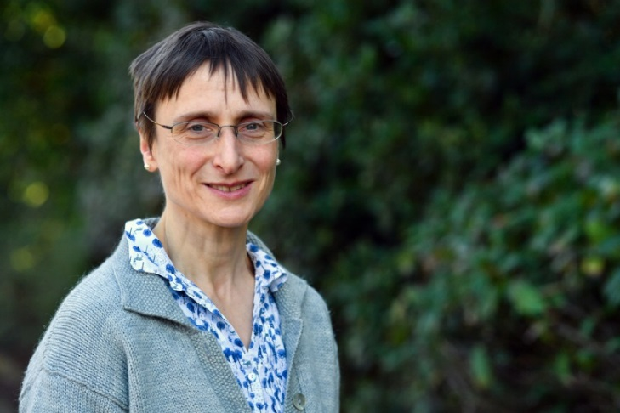
Prof. Roey Sweet, AHRC
“a transformational opportunity for early career researchers in the arts and humanities. The significance and the length of these prestigious awards are unprecedented in arts and humanities funding and they will give the opportunity for the brightest and best to realise their boundless potential.”
https://ahrc.ukri.org/newsevents/news/ukri-future-leaders-fellowships-scheme/
Notes:
Working to make this reality – starting with 10% of applicants in A&H disciplines, aiming to grow

Slide 13
fin.
Joanna Dunster, Strategy and Development Manager
8th November 2018

